Slide 1
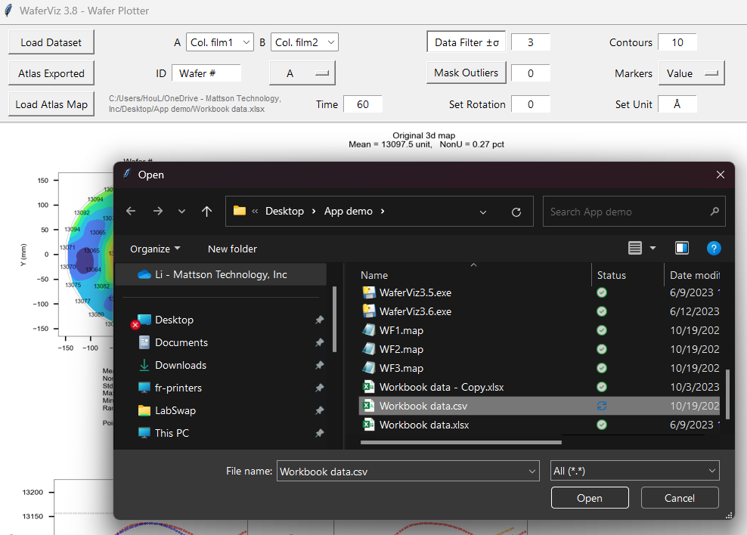
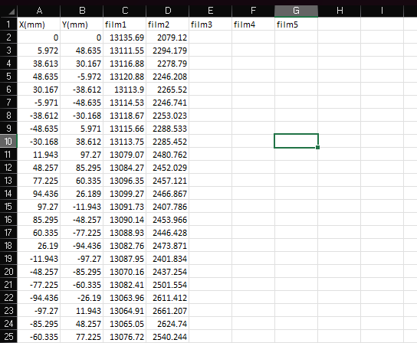
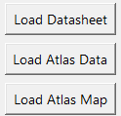




















Step1: Loading Data from Datasheets You Prepared - Choice 1
Copy and paste your raw data into Excel or CVS sheet with columns: x, y, data1, data2, … , as shown below:
Column A and B are reserved for (x, y) coordination. All other columns are for measurement data.
The first row is for column labels as you can put notes there or leave it blank.
Don’t put anything on unoccupied cells to avoid errors.
You must close the datasheet before loading otherwise it won’t work.
Click “Load Datasheet” to load.
Example

Slide 2
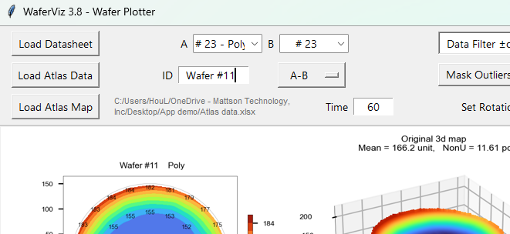
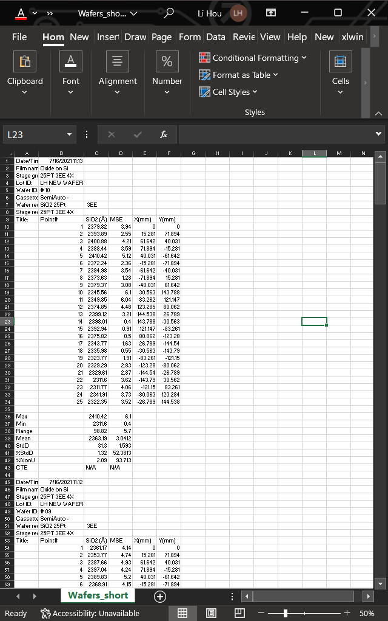
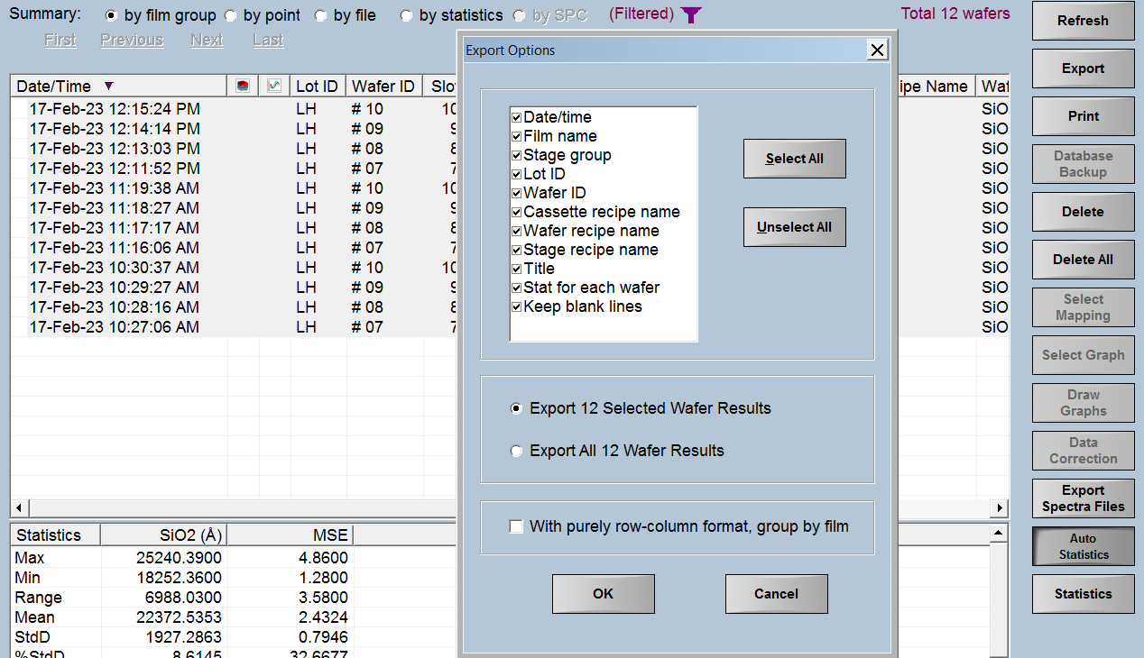



Step1: Loading Data from Exported Atlas Data - Choice 2
On Atlas tool screen click “Export” and “Select All” button as shown below.
Click “Load Atlas Data” to select exported files from the server.
Keep the data file closed otherwise it won’t work.
The exported raw data are shown in far right.
Example

Slide 3
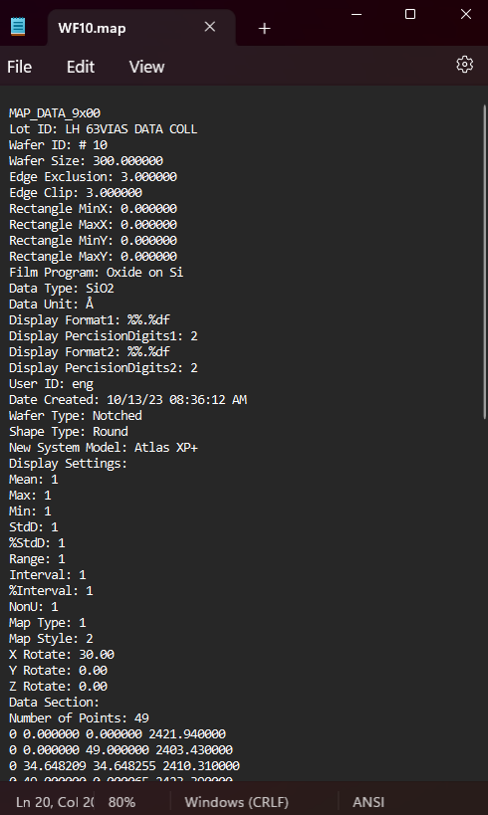
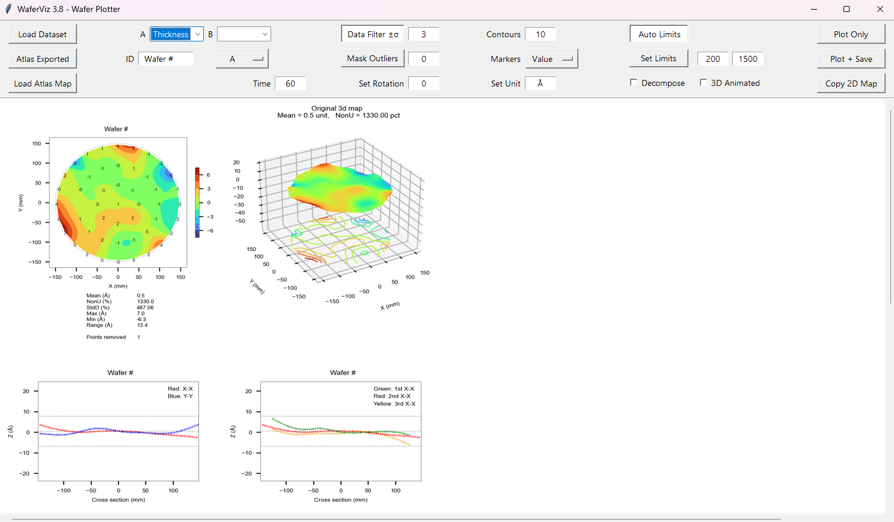
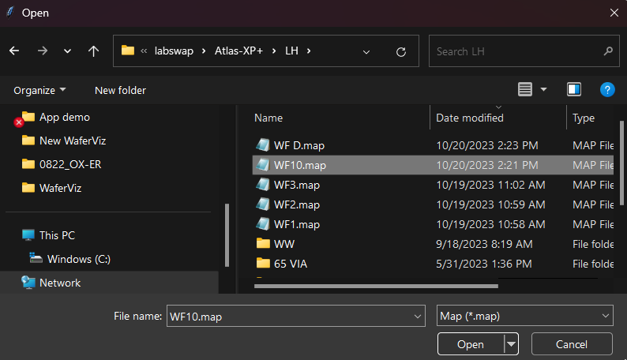

Step1: Loading Data from Atlas Map Files - Choice 3
Click “Load Atlas Map” and select map files from the server.
Since there is only one dataset involved so select “Thickness” for “A” and select “A” from dropdown button (or “A/t” if you want to calculate the rate).
The map file looks like in left when it is opened by Notepad.

Slide 4
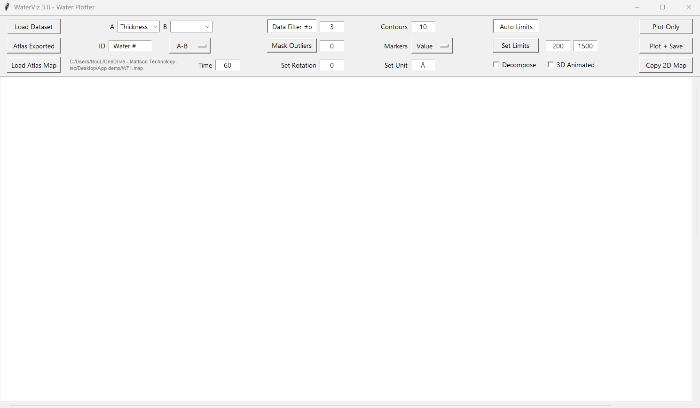


Step2: Configuring Settings.
2
6
8
11
3
4
7
9
10
1
5
The path to files.
A, B can be two films of pre-process and post-process.
You can enter the ID.
Operators, see right side.
You can enter process time to get rates but need to select (A-B)/t or (B-A)/t to be effective.
Default “Data Filter ±σ” is set ±3σ. Beyond that the data points will be excluded. The number of excluded points is shown in the contour map.
If “Mask Outliers” is pressed, you can find sigma value in the contour map according to the number of points you’ve removed.
You can enter the number of contours from 1 to 100 for the contour map.
Marker choices for the contour map, see right side.
The default unit is Å. You can change it to any physical units such as °C, Ohm/sq, etc.
If “Set Limits” is pressed, You can define lower limit and up limit.
4. Operators:
9. Marker choices for the contour map:

Slide 5
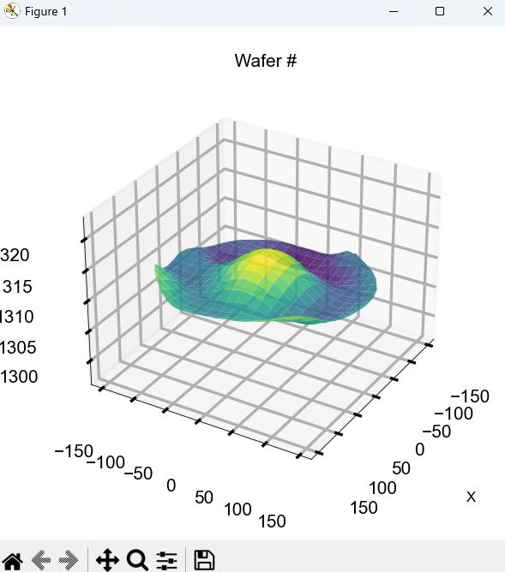
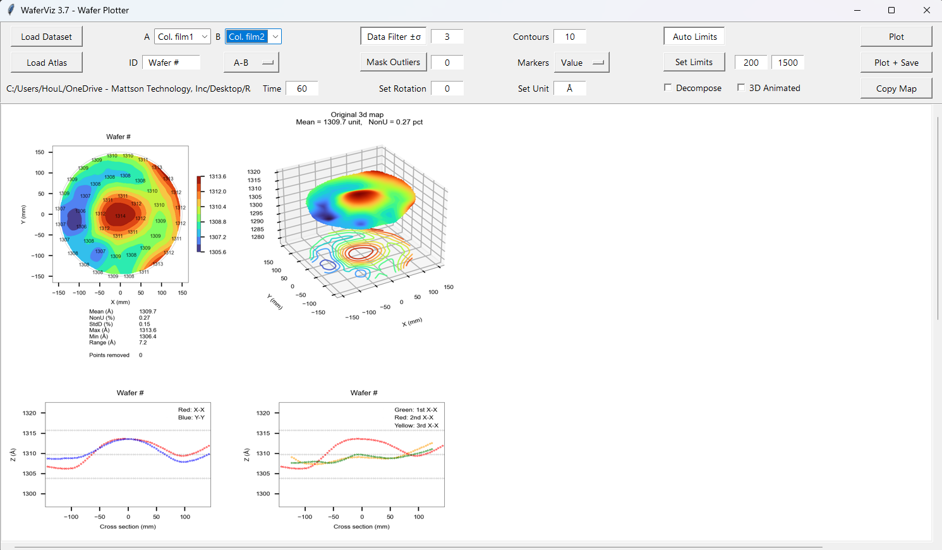
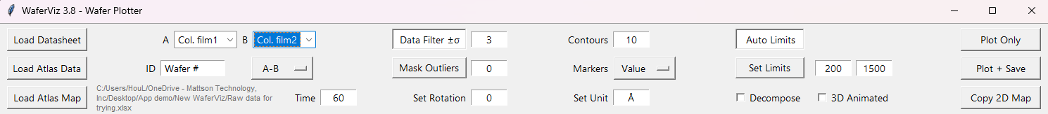
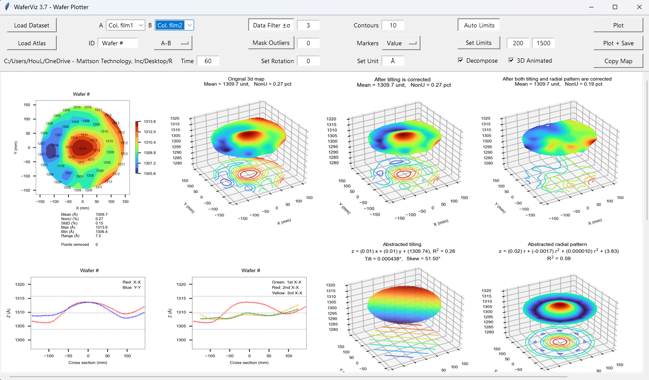
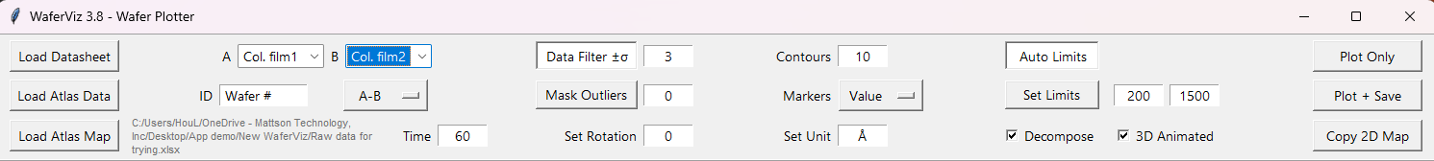
Step3: Plotting.
By clicking on “Plot” it only takes few seconds to produce the minimal graphs.
Selecting “Decompose” and/or “3D Animated” and “Plot” will take 22s.

Slide 6
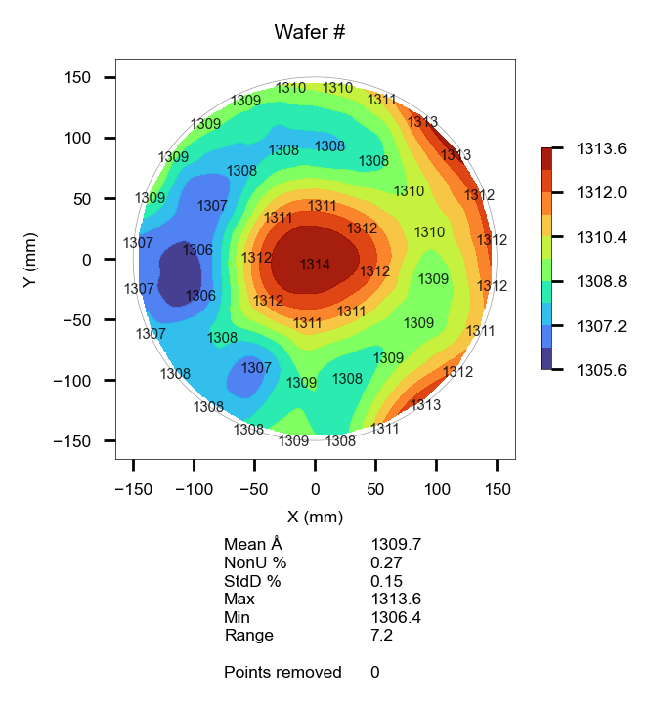

Step3: Copy / Paste the Graph with One Click.
This is a convenient shortcut.
After graphs are plotted, clicking “Copy Map” will copy 2D contour map into Windows’ clipboard which allows you to paste it to other apps.

Slide 7
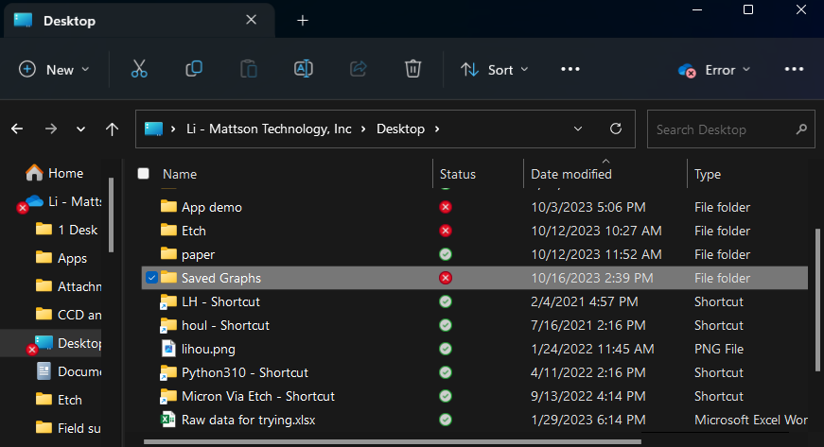
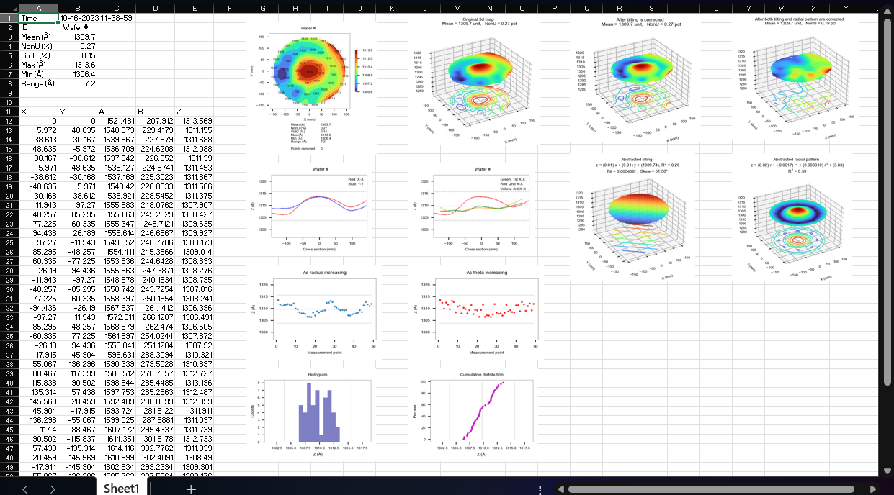
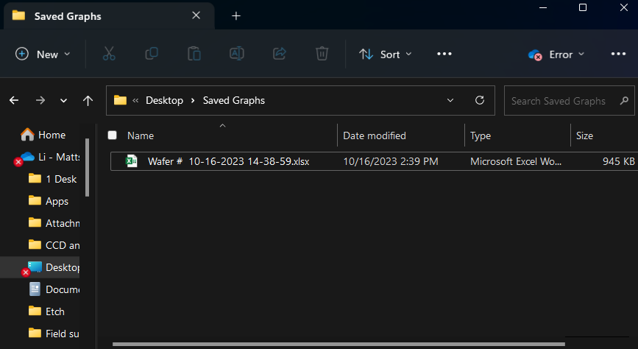
Step4: Saving Graphs.
Clicking “Plot + Save” instead of “Plot Only” adds an Excel summary sheet in auto-generated folder “Saved Graphs”.
The folder is in the same directory where you have dropped this app into.

